Slide 1
Computer Network (CS3002)
Spring Semester (2021-2022)
Dr. Judhistir Mahapatro
Department of Computer Science and Engineering
National Institute of Technology Rourkela

Slide 2
The Data Link Layer

Slide 3
Organization of this Lecture:
Data link layer design issues
Framing
Error control
Flow control
Elementary data link protocols
Summary

Slide 4
Data Link Layer Design Issues
Network layer services
Framing
Error control
Flow control

Slide 5
Data Link Layer
Algorithms for achieving:
  Reliable and Efficient communication of a whole units – frames (as opposed to bits – Physical Layer) between two machines.
Two machines are connected by a communication channel that acts conceptually like a wire (e.g., telephone line, coaxial cable, or wireless channel).
Essential property of a channel that makes it “wire-like” connection is that the bits are delivered in exactly the same order in which they are sent.

Slide 6
Data Link Layer
For ideal channel (no distortion, unlimited bandwidth and no delay)
  the job of data link layer would be trivial.
For non-ideal channel (limited bandwidth, distortions and delay)
  makes this job very difficult.

Slide 7
Data Link Layer Design Issues
Physical layer delivers bits of information to and from data link layer.
The functions of Data Link Layer are:
  Providing a well-defined service interface to the network layer.
  Dealing with transmission errors.
  Regulating the flow of data so that slow receivers are not swamped by fast senders.
Data Link layer
  Takes the packets from Network Layer
  Encapsulates them into frames

Slide 8
Data Link Layer Design Issues
Each frame has a
    frame header
    a payload field for holding the packet, and
    frame trailer.
Frame Management is what Data Link Layer does.

Slide 9
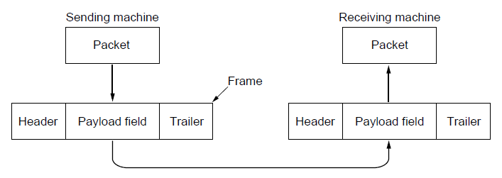
Packets and Frames
Relationship between packets and frames.

Slide 10
Services Provided to the Network Layer
Principal Service Function is to transfer the data from the network layer on the source machine to the network layer on the destination machine.
  Process in the network layer that hands some bits to the data link layer for transmission.
  Job of data link layer is to transmit the bits to the destination machine so they can be handed over to the network layer there.

Slide 11
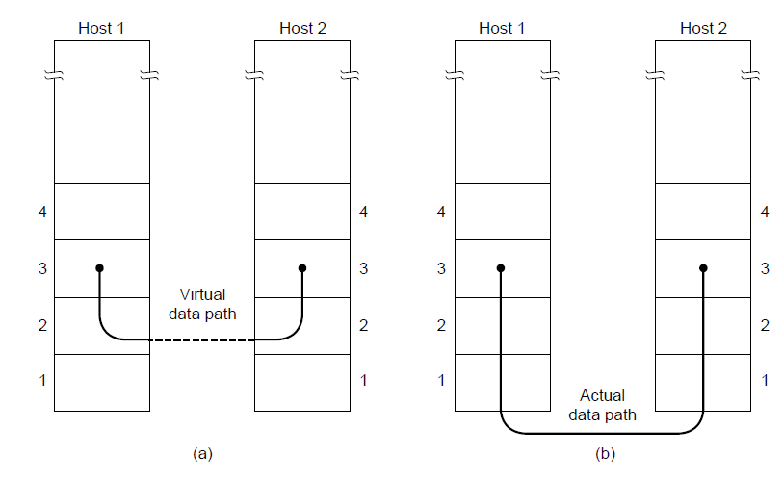
Network Layer Services
(a) Virtual communication. (b) Actual communication.

Slide 12
Possible Services Offered
Unacknowledged connectionless service.
Acknowledged connectionless service.
Acknowledged connection-oriented service.

Slide 13
Unacknowledged Connectionless Service
The source machine send independent frames to the destination machine without having the destination machine acknowledge them.
Example:
Ethernet is a data link layer protocol that provides this class of service
Voice over IP- In all the communication channel were real time operation is more important that quality of transmission.

Slide 14
Acknowledged Connectionless Service
Each frame send by the Data Link layer is acknowledged and the sender knows if a specific frame has been received or lost.
The protocol uses a specific time period that if the time has passed without getting acknowledgment
  it will re-send the frame.
This service is useful for communication when an unreliable channel is being utilized (e.g., 802.11 WiFi).

Slide 15
Acknowledged Connectionless Service (cont…)
Network layer does not know the frame size and other restriction of the data link layer.
  It becomes necessary for data link layer to have some mechanism to optimize the transmission.

Slide 16
Acknowledged Connection Oriented Service
Source and Destination establish a connection first.
Each frame sent is numbered
  Data link layer guarantees that each frame sent is indeed received.
  It guarantees that each frame is received only once and that all frames are received in the correct order.
Examples:
  Satellite channel communication,
  Long-distance telephone communication, etc.

Slide 17
Acknowledged Connection Oriented Service
Three distinct phases:
  Connection is established by having both side initialize variables and counters needed
    to keep track of which frames have been received and which ones have not.
  One or more times frames are transmitted.
  Finally, the connection is released – freeing up the variables, buffers, and other resources used to maintain the connection.

Slide 18
Framing
To provide service to the network layer the data link layer must use the service provided to it by physical layer.
Stream of data bits provided to data link layer is not guaranteed to be without errors.
Errors could be:
  Number of received bits does not match number of transmitted bits (deletion or insertion)
  Bit Value
It is up to data link layer to correct the errors if necessary.

Slide 19
Framing
Transmission of the data link layer starts with breaking up the bit stream
  into discrete frames
  Computation of a checksum for each frame
  Include the checksum into the frame before it is transmitted.
Receiver computes its checksum error for a receiving frame
  if it is different from the checksum that is being transmitted will have to deal with the error.
Framing is more difficult than one could think!

Slide 20
Framing Methods
Byte count.
Flag bytes with byte stuffing.
Flag bits with bit stuffing.
Physical layer coding violations.

Slide 21
Byte Count
It uses a field in the header to specify the number of bytes in the frame.
Once the header information is being received it will be used to determine end of the frame.
Trouble with this algorithm is that when the count is incorrectly received the destination will get out of synch with transmission.
  Destination may be able to detect that the frame is in error
  Destination does not have a means (in this algorithm) how to correct it.

Slide 22
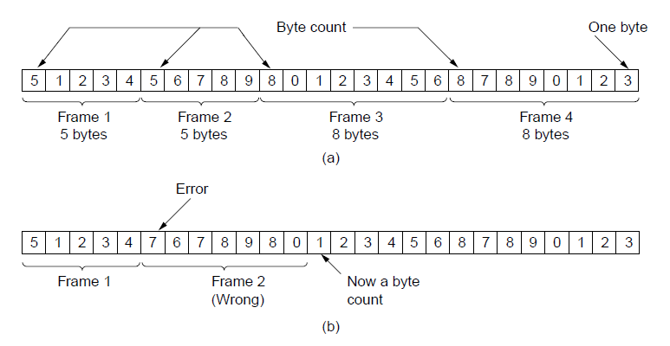
Example of Byte Count
A byte stream. (a) Without errors. (b) With one error.

Slide 23
Flag Bytes with Byte Stuffing
This methods gets around the boundary detection of the frame
  append the frame start and frame end special bytes.
If they are the same (beginning and ending byte in the frame) they are called flag byte.
If the actual data contains a byte that is identical to the FLAG byte (e.g., picture, data stream, etc.)
  escape character is inserted just before the “FLAG” character.

Slide 24
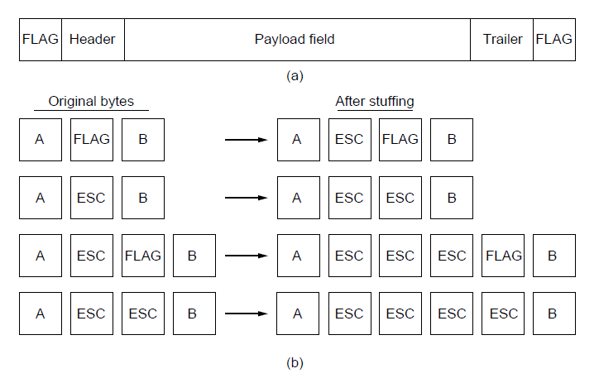
Example of Byte Stuffing

Slide 25
Flag Bits with Bit Stuffing
This methods achieves the same as Byte Stuffing method by using Bits (1 bit) instead of Bytes (8 Bits).
Developed for High-level Data Link Control protocol.
Each frames begins and ends with a special bit pattern:
  01111110 or 0x7E <- Flag Byte
  Whenever the sender’s data link layer encounters five consecutive 1s in the data it automatically stuffs a 0 bit into the outgoing bit stream.
  Ensures a minimum density of transitions that help physical layer maintain synchronization.
  USB (Universal Serial Bus) uses bit stuffing.

Slide 26
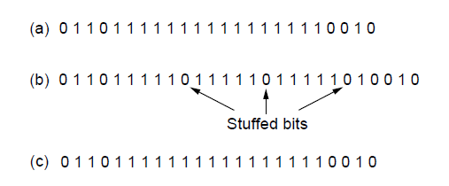
Example of bit stuffing
Bit stuffing. (a) The original data. (b) The data as they appear on the line. (c) The data as they are stored in the receiver’s memory after destuffing.

Slide 27
Physical Layer Coding Violation Framing
Use a shortcut from the physical layer.
Encoding of bits as signals often includes redundancy to help the receiver
  Some signal will not appear in the regular data
  Example, 4B/5B line code 4 data bits are mapped to 5 signal bits to ensure sufficient bit transitions.
  We can use some reserved signals to indicate the start and end of frames.
  Coding violations to delimit frames.
  No need to stuff the data.

Slide 28
Framing
With bit stuffing, the increase would be roughly 12.5% as 1 bit is added to every byte as compared to 100% increase in byte stuffing.

Slide 29
Framing
Many data link protocols use a combination of presented methods for safety.
  For example in Ethernet and 802.11 each frame begin with a well-defined pattern called a preamble.
Preamble is typically 72 bits long.
It is then followed by a length field.

Slide 30
Error Control
After solving the marking of the frame with start and end, the data link layer has to handle eventual errors in transmission or detection.
  Ensuring that all frames are delivered to the network layer at the destination and in proper order.
Unacknowledged connectionless service: it is OK for the sender to output frames regardless of its reception.
Reliable connection-oriented service: it is NOT OK.

Slide 31
Error Control
Reliable connection-oriented service usually will provide a sender with some feedback about what is happening at the other end of the line.
  Receiver Sends Back Special Control Frames.
  If the Sender Receives positive Acknowledgment, then it will know that the frame has arrived safely.

Slide 32
Error Control
Timer and Frame Sequence Number for the Sender is Necessary to handle the case when there is no response (positive or negative) from the Receiver .
  Timer to handle no acknowledgement
  Retransmissions may cause the same frame received by the network layer two or more times.

Slide 33
Flow Control
Important Design issue for the cases when the sender is running on a fast powerful computer and receiver is running on a slow low-end machine.
Receiver may unable to handle the frames as fast as they arrive and will lose some.
Two approaches:
  Feedback-based flow control
  Rate-based flow control

Slide 34
Feedback-based Flow Control
Receiver sends back information to the sender giving it permission to send more data, or
Telling sender how receiver is doing.

Slide 35
Rate-based Flow Control
Built in mechanism that limits the rate at which sender may transmit data
  Without the need for feedback from the receiver.
Link layer hardware is designed to run fast enough that it does not cause loss.
Network Interface Cards are sometimes said to run at wire speed, they can handle the frames as fast as they can arrive on the link
  Any overruns are handled by higher layers.

Slide 36
Error Detection and Correction
Optical fiber in telecommunication networks have tiny error rates
  The transmission errors are a rare occurrence.
Especially, wireless links and aging local loops have error rates that are orders of magnitude larger.

Slide 37
Error Detection and Correction
Two basic strategies to deal with errors:
  Include enough redundant information to enable the receiver to deduce what the transmitted data must have been.
      Error correcting codes. Often referred to as FEC (Forward Error Correction)
  Include only enough redundancy to allow the receiver to deduce that an error has occurred (but not which error).
      Error detecting codes.

Slide 38
Error Detection and Correction
Error detecting codes is cheaper to use in highly reliable channels such as fiber.
FEC is used on noise channels because retransmissions are required often.

Slide 39
Error Detection and Correction
The redundant bits that offer protection are as likely to be received in error.
  Neither of methods can handle all possible errors.

Slide 40
Error Detection and Correction
Two error models
  Isolated single-bit errors due to thermal noise.
  Errors tend to come in bursts rather than singly.
    If block size was 1000 bits and error rate was 0.001 per bit, then errors were independent and most blocks contain an error.
    If errors come in bursts of 100, then only one block would be affected.
      Much harder to correct the burst errors.

Slide 41
Error Detection and Correction
Sometimes, the location of an error will be known, perhaps the physical layer received an analog signal that was far from the expected value for a 0 or 1 and declared the bit to be lost. This situation is called an erasure channel.
  Easier to correct errors in erasure channel.
  At least know which bit is in error.

Slide 42
Error Detection and Correction
Error codes have been developed after long fundamental research conducted in mathematics.
Many protocol standards get codes from the large field in mathematics.

Slide 43
Error Detection and Correction
Error codes are examined in Link Layer because this is the first place that we have run up against the problem of reliability transmitting groups of bits.
  Codes are reused because reliability is an overall concern.
  The error correcting code are also seen in the physical layer for noise channels.
  Commonly they are used in link, network and transport layer.

Slide 44
Error Detection & Correction Code
Hamming codes.
Binary convolutional codes.
Reed-Solomon codes.
Low-Density Parity Check codes.

Slide 45
Error Detection & Correction Code
All the codes add redundancy to the information that is being sent.
A frame consists of
  m data bits (message) and
  r redundant bits (check).
Block code - the r check bits are computed solely as function of the m data bits with which they are associated.
  m data bits were looked up in a large table to find their corresponding r check bits.

Slide 46
Error Detection & Correction Code
Systemic code – the m data bits are send directly along with the check bits.
Linear code – the r check bits are computed as a linear function of the m data bits.
  XOR or modulo 2 addition is a popular.

Slide 47
Error Detection & Correction Code
n – total length of a block (i.e., n = m + r)
(n, m) – code
n – bit codeword containing n bits.
m/n – code rate (range ½ for noisy channel and close to 1 for high-quality channel).

Slide 48
Error Detection & Correction Code
Example
Transmitted: 10001001
Received: 10110001
XOR operation gives number of bits that are different.
XOR: 00111000
Number of bit positions in which two codewords differ is called Hamming Distance.
It shows that two codes are d=3 distance apart, and it will require d=3 errors to convert one into the other.

Slide 49
Error Detection & Correction Code
All 2^{m} possible data messages are legal, but due to the way the check bits are computed not all 2^{n} possible code words are used.
Only small fraction of 2^{m}/2^{n}=1/2^{r} are possible will be legal codewords.
The error-detecting and error-correcting codes of the block code depend on this Hamming distance.
To reliably detect d error, one would need a distance d+1 code.
To correct d error, one would need a distance 2d+1 code.

Slide 50
Example
4 valid codes:
  0000000000, 0000011111, 1111100000, 1111111111
Minimal Distance of this code is 5 => can correct double errors and it detect quadruple errors.
0000000111 => single or double – bit error. Hence the receiving end must assume the original transmission was 0000011111.
0000000000 => had triple error that was received as 0000000111 it would be detected in error.

Slide 51
Error Detection & Correction Code
One cannot perform double errors and at the same time detect quadruple errors.
Error correction requires evaluation of each candidate codeword which may be time consuming search.
The task of decoding by finding the legal codeword that is closest to the received codeword can be done by inspection

Slide 52
Error Detection & Correction Code
Through proper design this search time can be minimized.
Design a code with m message bits and r check bits that will allow all single errors to be corrected.
Each of 2^{m} legal messages has n illegal codewords at a distance of 1 from it.
Inverting each of the n bits in n-bit codeword formed from it. Thus, each of legal 2^{m} messages requires n+1 bit pattern
Must (n+1) 2^{m} <= 2^{n}

Slide 53
Error Detection & Correction Code
In theory if n = m + r, this requirement becomes:
  (m + r + 1) ≤ 2^{r}
  Puts the lower limit on the number of check bits needed to correct single errors.
  This theoretical lower limit can, in fact, be achieved using a method due to Hamming.

Slide 54
Hamming Code
Codeword: b1 b2 b3 b4 b5 b6 b7 b8 …
Check bits: The bits that are powers of 2
(p1 p2 b3 p4 b5 b6 b7 p8…)
The rest of bits (p1 p2 m3 p4 m5 m6 m7 p8…) are filled with m data bits.

Slide 55
The Hamming Code
Consider a message having four data bits (D) which is to be transmitted as a 7-bit codeword by adding three error control bits. This would be called a (7,4) code. The three bits to be added are three EVEN Parity bits (P), where the parity of each is computed on different subsets of the message bits as shown below.
7 | 6 | 5 | 4 | 3 | 2 | 1
D | D | D | P | D | P | P | 7-BIT CODEWORD
D | - | D | - | D | - | P | (EVEN PARITY)
D | D | - | - | D | P | - | (EVEN PARITY)
D | D | D | P | - | - | - | (EVEN PARITY)

Slide 56
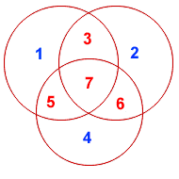
Hamming Code
For example, data bit 3 contributes to parity bits 1 and 2.
Each circle (parity bit) encompasses a total of four bits, and each circle must have EVEN parity.
Given four data bits, the three parity bits can easily be chosen to ensure this condition.

Slide 57
Hamming Code
It can be observed that changing any one bit numbered 1..7 uniquely affects the three parity bits.
Changing bit 7 affects all three parity bits, while an error in bit 6 affects only parity bits 2 and 4, and an error in a parity bit affects only that bit.
The location of any single bit error is determined directly upon checking the three parity circles.

Slide 58
Hamming Code
For example, the message 1101 would be sent as 1100110, since:
7 | 6 | 5 | 4 | 3 | 2 | 1
1 | 1 | 0 | 0 | 1 | 1 | 0 | 7-BIT CODEWORD
1 | - | 0 | - | 1 | - | 0 | (EVEN PARITY)
1 | 1 | - | - | 1 | 1 | - | (EVEN PARITY)
1 | 1 | 0 | 0 | - | - | - | (EVEN PARITY)
Parity bit 1 -> 3 5 7
Parity bit 2 -> 3 6 7
Parity bit 4 -> 5 6 7

Slide 59
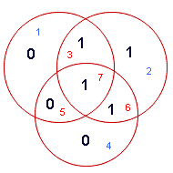
Hamming Codes
It can be confirmed that the choice of these three parity bits ensures that the parity within each circle is EVEN.
if an error occurs in any of the seven bits, that error will affect different combinations of the three parity bits depending on the bit position.

Slide 60
Hamming Code
For example, suppose the above message 1100110 is sent and a single bit error occurs such that the codeword 1110110 is received:
transmitted message Rceived message
1 1 0 0 1 1 0 ------------> 1 1 1 0 1 1 0
BIT: 7 6 5 4 3 2 1 BIT: 7 6 5 4 3 2 1

Slide 61
Hamming Code
7 | 6 | 5 | 4 | 3 | 2 | 1
1 | 1 | 1 | 0 | 1 | 1 | 0 | 7-BIT CODEWORD
1 | - | 1 | - | 1 | - | 0 | (EVEN PARITY) | NOT! | 1
1 | 1 | - | - | 1 | 1 | - | (EVEN PARITY) | OK! | 0
1 | 1 | 1 | 0 | - | - | - | (EVEN PARITY) | NOT! | 1
The above error (in bit 5) can be corrected by examining which of the three parity bits was affected by the bad bit:

Slide 62
Hamming Code
The value of the Hamming code can be summarized:
  Detection of 2 bit errors (assuming no correction is attempted);
  Correction of single bit errors;
  Cost of 3 bits added to a 4-bit message.
  The ability to correct single bit errors comes at a cost which is less than sending the entire message twice.
    (Recall that simply sending a message twice accomplishes no error correction.)

Slide 63
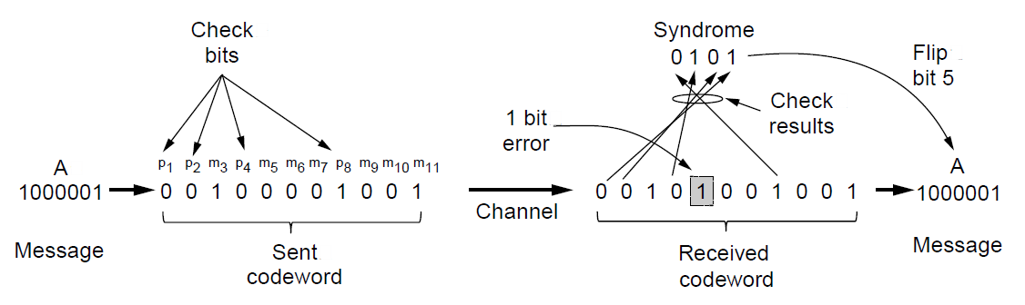
Error Detection Codes
Example of an (11, 7) Hamming code
correcting a single-bit error.

Slide 64
Convolutional Codes
Not a block code
There is no natural message size or encoding boundary as in a block code.
The output depends on the current and previous input bits. Encoder has memory.
The number of previous bits on which the output depends is called the constraint length of the code.
They are deployed as part of the
  GSM mobile phone system
  Satellite Communications, and
  802.11

Slide 65
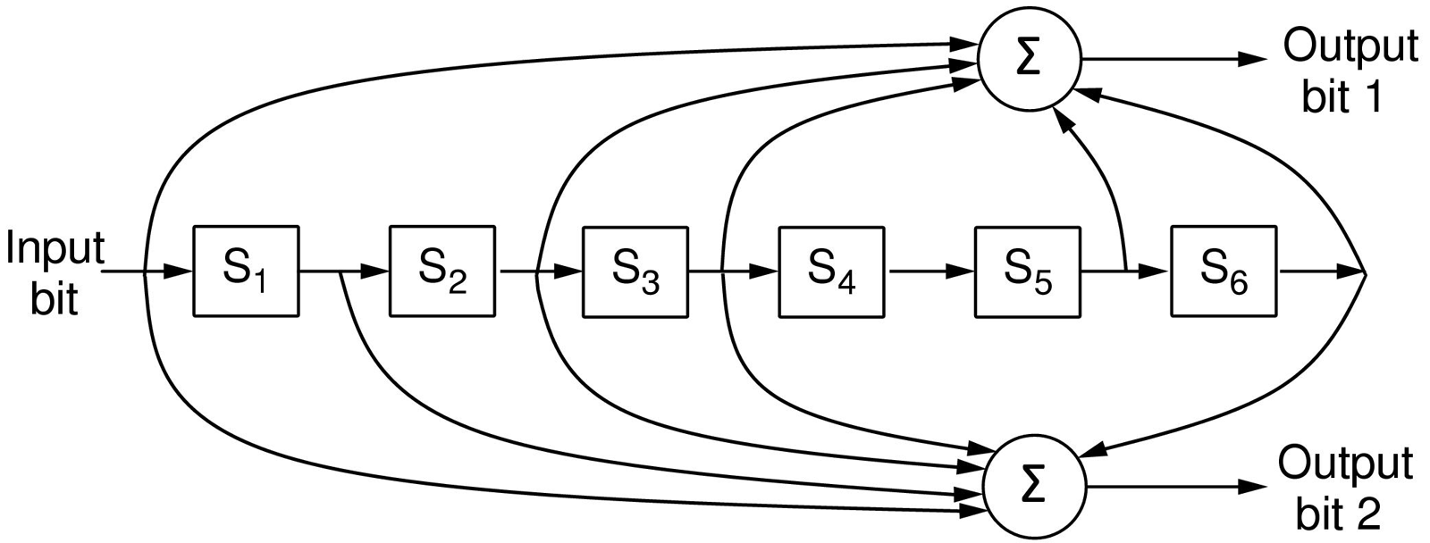
Error Detection Codes
The NASA binary convolutional code used in 802.11.
Input Register values
111 → 100000 after first bit is inputted
110000 after second bit is inputted
111000 after third bit is inputted

Slide 66
Convolutional Encoders
Like any error-correcting code, a convolutional code works by adding some structured redundant information to the user's data and then correcting errors using this information.
A convolutional encoder is a linear system.

Slide 67
Convolutional Encoders
A binary convolutional encoder can be represented as a shift register.
  The outputs of the encoder are modulo 2 sums of the values in the certain register's cells.
The input to the encoder is either the unencoded sequence (for non-recursive codes) or the unencoded sequence added with the values of some register's cells (for recursive codes).

Slide 68
Error-Detecting Codes
Linear, systematic block codes
Parity.
Checksums.
Cyclic Redundancy Checks (CRCs).

Slide 69
Parity
Error-detecting code, in which a single parity bit is appended to the data.
Parity bit is chosen so that the number of 1 bits in the codeword is even or (odd)
1011010 sent in even parity
10110100 (even parity)
1011010 sent in odd parity
10110101 (odd parity)
Any single bit error produces a codeword with the wrong parity. It detects single bit errors.

Slide 70
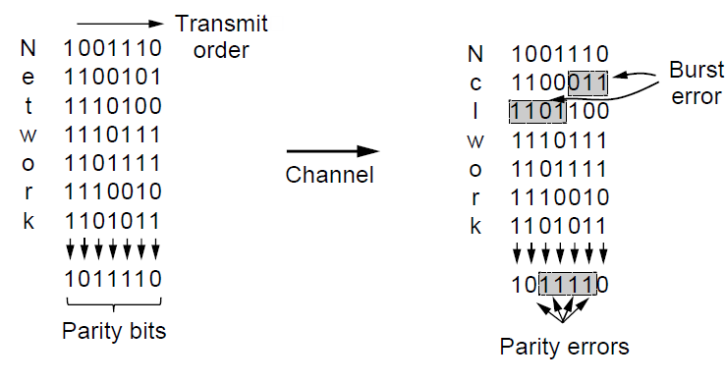
Error-Detecting Codes
Interleaving of parity bits to detect a burst error.

Slide 71
Checksum
It is closely related to the group of parity bits.
It is used to mean a group of parity bits associated with a message, regardless of how are calculated.
Sum of data bits of a message.
  Checksum is placed at the end of the message, as the complement of the sum function.

Slide 72
CRC
Also known as a polynomial code.
For example, 11001 has 6 bits and thus, represents a six-term polynomial with coefficients 1, 1, 0, 0, 0, and 1:
1x⁵ + 1x⁴ +0x³ + 0x² + 0x¹ + 1x⁰

Slide 73
CRC
Sender and receiver must agree upon a generator polynomial, G(x), in advance.
Both low- and high- order bits of the generator must be 1.
Frame with m bits corresponding to the polynomial M(x), must be longer than the polynomial generator.

Slide 74
CRC
Let r be the degree of G(x). Append r zero bits to the low-order end of the frame.
  m + r bits and corresponds to the polynomial x^{r}M(x)
Divide the bit string corresponding to G(x) into the bit string corresponding to x^{r}M(x), using modulo 2 division.
Subtract the remainder from the bit string corresponding to x^{r}M(x) using modulo 2 subtraction. The result is the checksummed frame to be transmitted.

Slide 75
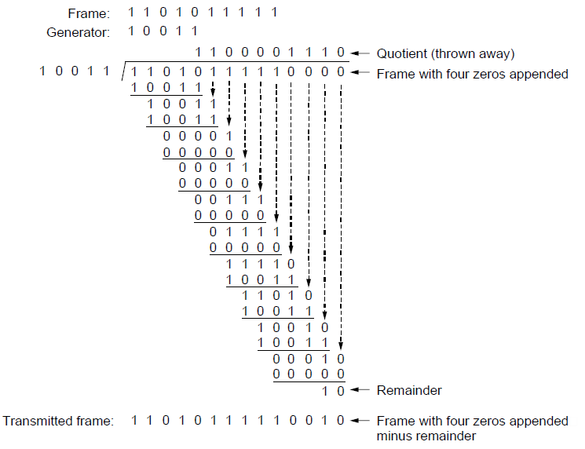
Error-Detecting Codes (Cyclic Redundancy Check)
Example calculation of the CRC

Slide 76
Error-Detecting Codes (Cyclic Redundancy Check)
It should be clear that T(x) is divisible (modulo 2) by G(x)
If it is zero, then no error in the transmission.

Slide 77
Reference
Computer Networks, Fifth Edition by Andrew Tanenbaum and David Wetherall, Pearson Education-Prentice Hall, 2011

